Slide 1
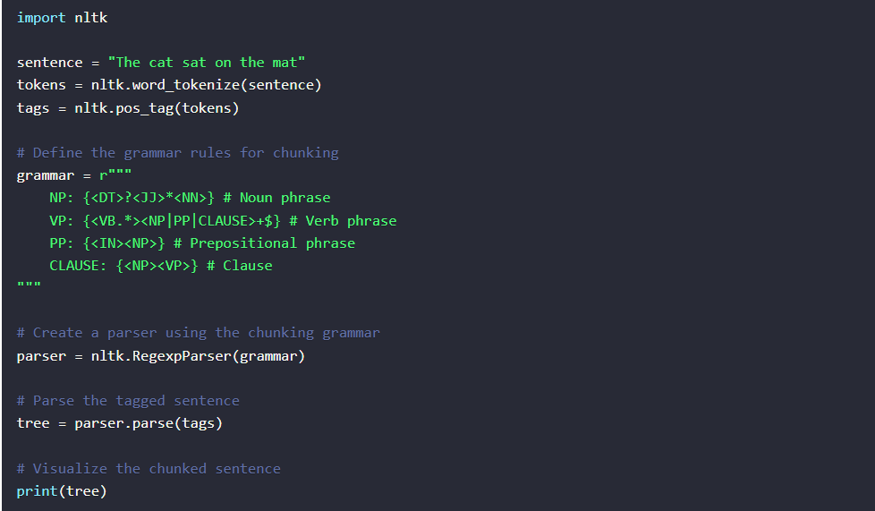
NLP Newbie Training 1. Chunking
Chunking is the process of grouping words together into "chunks" based on their part of speech tags. It is also known as shallow parsing. Chunking helps in identifying and extracting meaningful phrases or noun phrases (NP), verb phrases (VP), and prepositional phrases (PP) from sentences.
Output: (S (NP The/DT cat/NN) (VP (VBD sat/VBD) (PP on/IN (NP the/DT mat/NN))))

Slide 2
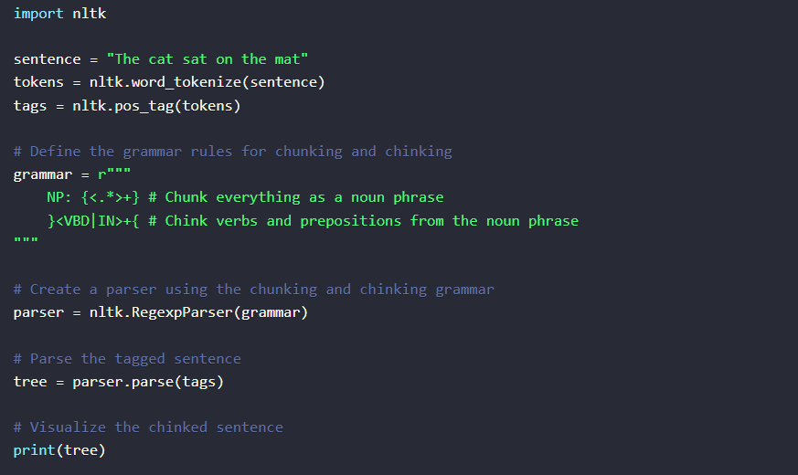
2. Chinking
Chinking is the process of removing specific chunks from a chunked sentence. It allows us to specify patterns that should not be included in the chunks. Chinking is useful when we want to exclude certain words or phrases from the extracted chunks.
Output: (S (NP The/DT cat/NN sat/VBD) on/IN (NP the/DT mat/NN))

Slide 3
Applications of Chunking and Chinking:
Information Extraction: Chunking is used to extract specific information like names, locations, and organizations from unstructured text.
Named Entity Recognition: Chunking helps in identifying and classifying named entities in text, such as persons, organizations, and locations.
Text Classification: Chunking can be used as a feature extraction technique for text classification tasks, where the structure of sentences is important.
Question Answering: Chunking is useful in analyzing and understanding the syntactic structure of questions and finding relevant answers from large text corpora.

Slide 4
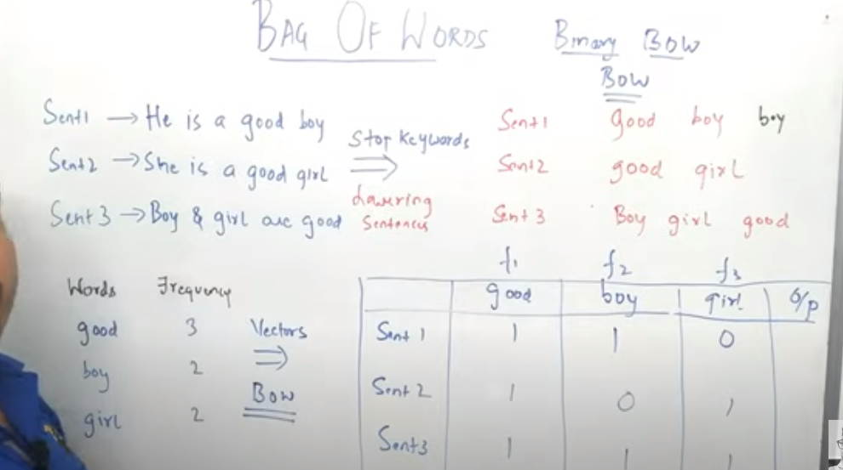
Word-Vectorization 1. Bag Of Words Bag of Words is a simple technique used to convert text data into numerical vectors that can be fed into machine learning algorithms. It focuses on the occurrence of words in a document without considering their order or structure. Here's how it works: Create a vocabulary: Build a list of unique words (tokens) from the entire corpus (collection of documents). Vectorization: For each document, create a vector where each dimension corresponds to a word in the vocabulary, and the value represents the frequency of that word in the document. Here's an example to illustrate the process: Let's say we have two sentences: Sentence 1: "The cat in the hat." Sentence 2: "The dog chased the cat.“ The vocabulary might be: ["The", "cat", "in", "the", "hat", "dog", "chased"] The BoW representation of these sentences would be: Sentence 1 BoW vector: [1, 1, 1, 1, 1, 0, 0] Sentence 2 BoW vector: [1, 1, 0, 2, 0, 1, 1] BoW has its limitations. It completely ignores the order of words and also fails to capture the semantic meaning of words. For example, "good" and "excellent" might be treated as completely separate words, even though they are closely related in meaning. Additionally, BoW doesn't consider grammar, word relationships, or context.

Slide 5
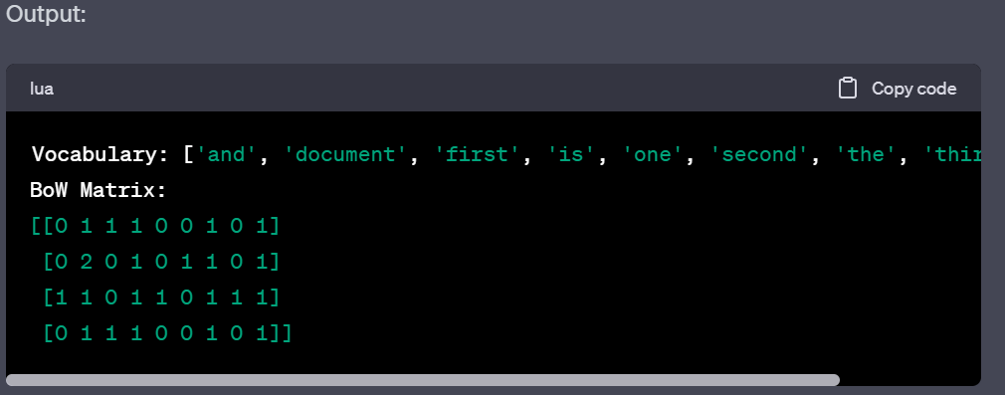
Bag of words implementation
from sklearn.feature_extraction.text import CountVectorizer
# Sample corpus (collection of documents)
corpus = [
"This is the first document.",
"This document is the second document.",
"And this is the third one.",
"Is this the first document?"
]
# Initialize the CountVectorizer
vectorizer = CountVectorizer()
# Fit and transform the corpus into a BoW representation
X = vectorizer.fit_transform(corpus)
# Convert to an array for better visualization
X_array = X.toarray()
# Get the vocabulary (list of words)
vocabulary = vectorizer.get_feature_names_out()
print("Vocabulary:", vocabulary)
print("BoW Matrix:")
print(X_array)

Slide 6
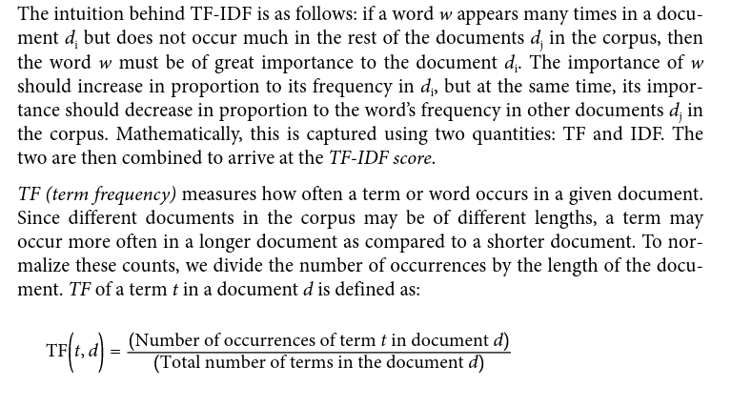
TF-IDF(term frequency and inverse document frequency) TF-IDF (Term Frequency-Inverse Document Frequency) is a numerical representation technique commonly used in Natural Language Processing (NLP) to transform text data into a format suitable for machine learning algorithms. It aims to capture the importance of words in a collection of documents by considering both the frequency of a word in a specific document and its rarity across the entire corpus. This helps in reducing the impact of common words and highlighting the significance of distinctive words in a document.

Slide 7
Formulas:
For TF:
Formula: TF(t, d) = (Number of times term t appears in document d) / (Total number of terms in document d)
For IDF:
Formula: IDF(t) = log(N / (1 + DF(t)))
N: Total number of documents in the corpus
DF(t): Number of documents containing term t
For TF-IDF:
Formula: TF-IDF(t, d) = TF(t, d) * IDF(t)

Slide 8
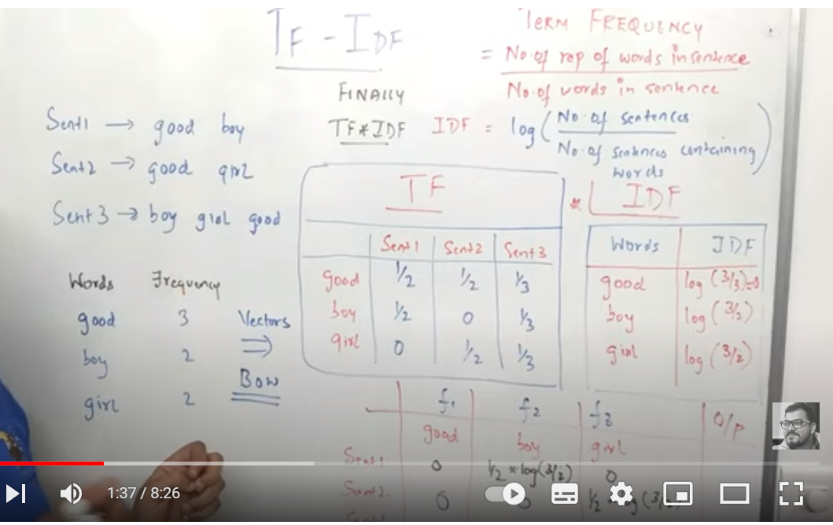
Code snippet:
from sklearn.feature_extraction.text import TfidfVectorizer
# Sample documents
documents = [
"This is the first document.",
"This document is the second document.",
"And this is the third one.",
"Is this the first document?"
]
# Create a TF-IDF vectorizer
tfidf_vectorizer = TfidfVectorizer()
# Fit and transform the documents
tfidf_matrix = tfidf_vectorizer.fit_transform(documents)
# Get the feature names (words)
feature_names = tfidf_vectorizer.get_feature_names_out()
# Convert the TF-IDF matrix to a dense array
tfidf_matrix_dense = tfidf_matrix.toarray()
# Print the TF-IDF matrix
print(tfidf_matrix_dense)

Slide 9
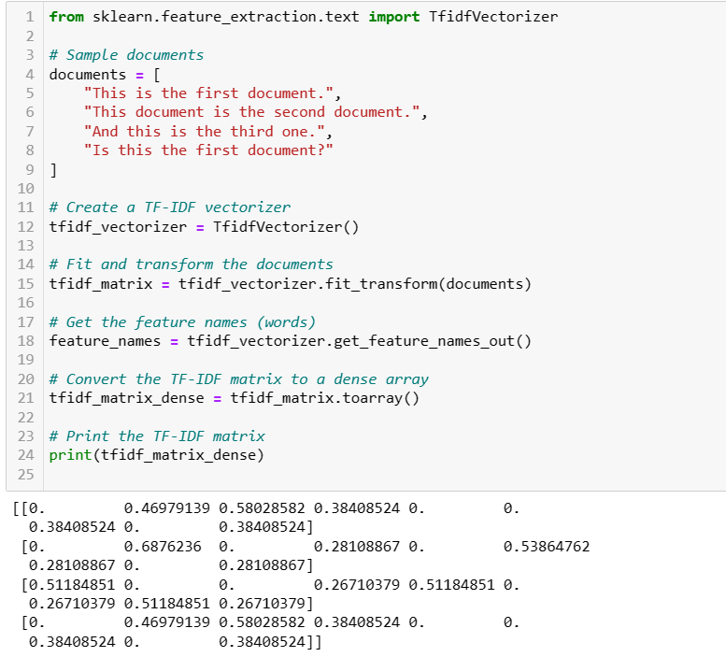
Code snippet:

Slide 10
Word Embeddings 1. word2vec:
Word2Vec is a popular algorithm used to create word embeddings in natural language processing (NLP). Word embeddings are dense vector representations of words in a continuous vector space, where similar words are closer together in the vector space, capturing semantic relationships between words.
Word2Vec comes in two main variants:
Continuous Bag of Words (CBOW) and Skip-gram. I'll provide a brief explanation of both along with some code examples using the gensim library in Python.
Continuous Bag of Words (CBOW):
CBOW aims to predict a target word given its context words (surrounding words). It learns to predict a target word based on the words around it.
Skip-gram:
Skip-gram is the reverse of CBOW. It aims to predict context words given a target word. It learns to predict context words from the target word.

Slide 11
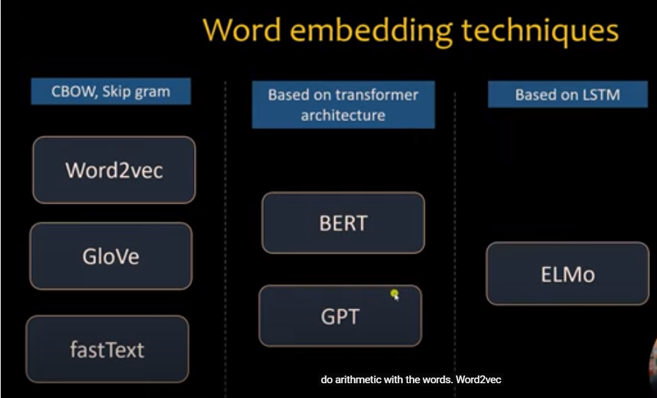
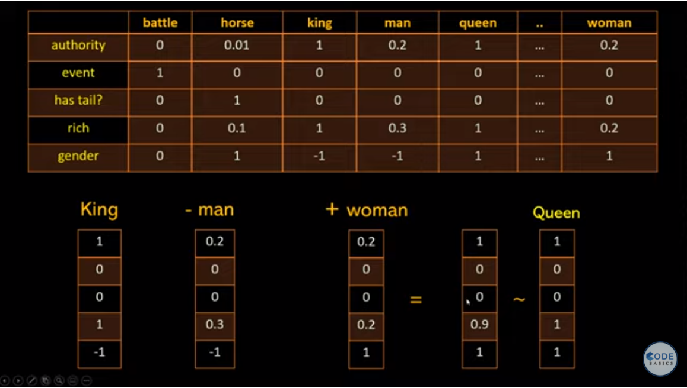
Word Embeddings

Slide 12
Word Embeddings 1. word2vec:
Word2Vec is a popular algorithm used to create word embeddings in natural language processing (NLP). Word embeddings are dense vector representations of words in a continuous vector space, where similar words are closer together in the vector space, capturing semantic relationships between words.
Word2Vec comes in two main variants:
Continuous Bag of Words (CBOW) and Skip-gram. I'll provide a brief explanation of both along with some code examples using the gensim library in Python.
Continuous Bag of Words (CBOW):
CBOW aims to predict a target word given its context words (surrounding words). It learns to predict a target word based on the words around it.
Skip-gram:
Skip-gram is the reverse of CBOW. It aims to predict context words given a target word. It learns to predict context words from the target word.

Slide 13
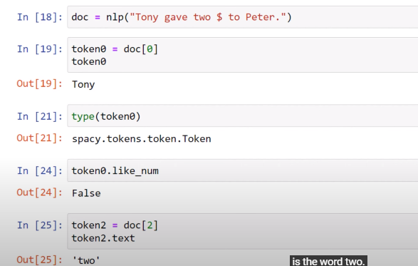
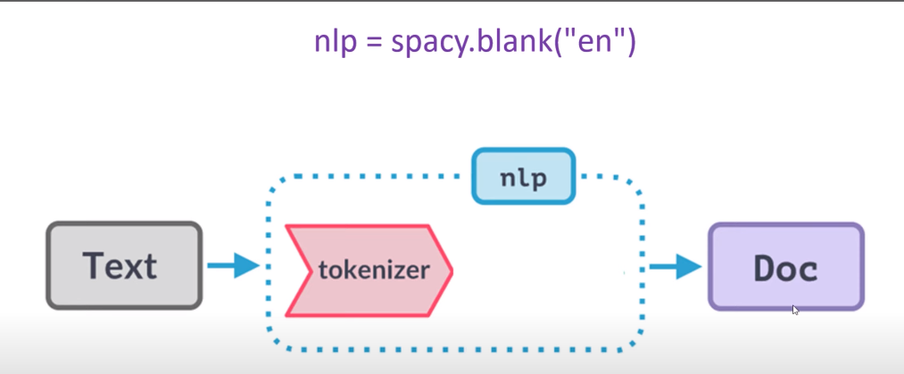
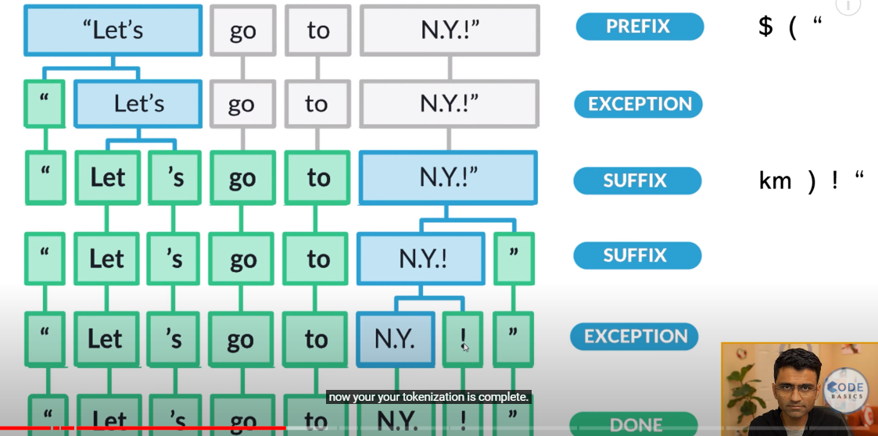
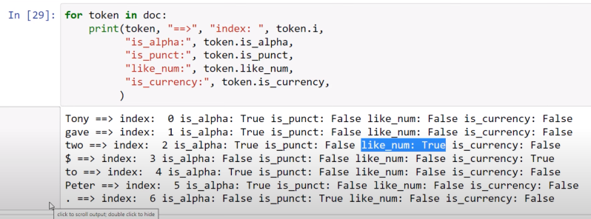
Tokenization (firstlanguage.in – perform various NLP Tasks) Splitting text into meaningful Segments

Slide 14
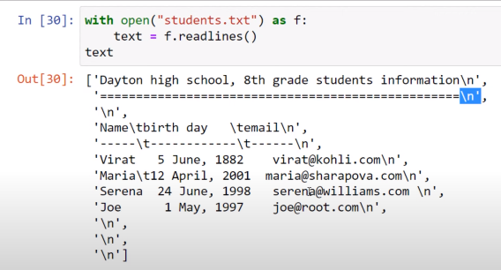
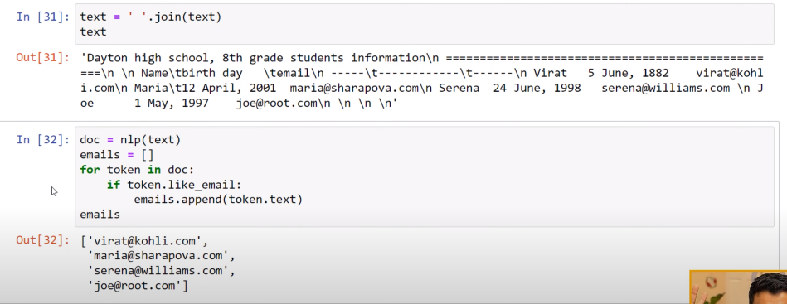
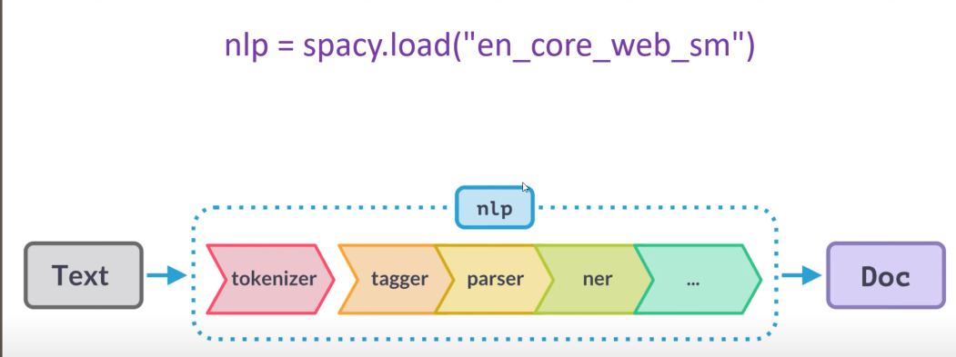
Tokenization (firstlanguage.in – perform various NLP Tasks) Splitting text into meaningful Segments

